Slide 1
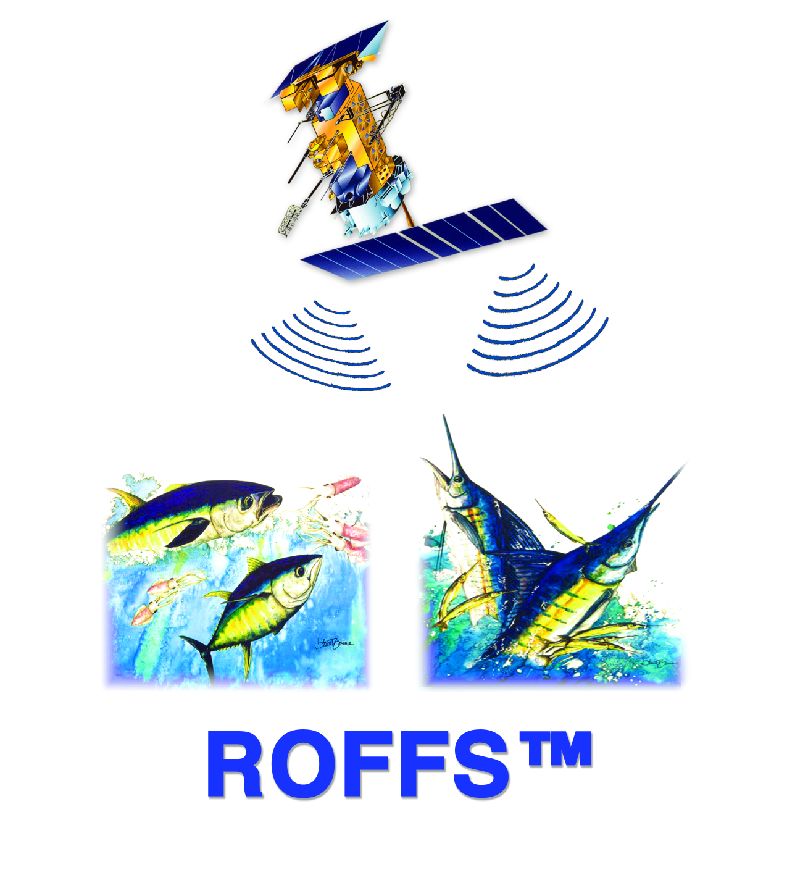



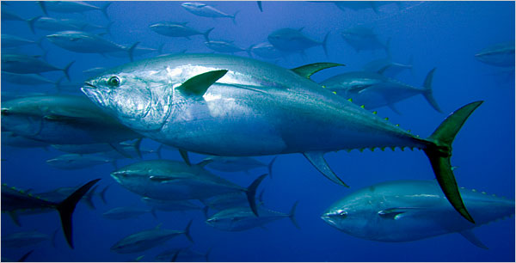
Spring spawning grounds of Atlantic tunas in the northern Gulf of Mexico: Environmental constraints and response to climate change
Barbara Muhling (CIMAS Univ. of Miami, NOAA SEFSC)
Yanyun Liu (NOAA AOML)
Sang-Ki Lee (NOAA AOML)
John Lamkin (NOAA SEFSC)
Mitch Roffer (ROFFS)
Matthew Upton (ROFFS)
Frank Muller-Karger (USF)
Notes:
NOAA/NASA collaboration. Multidisciplinary project that combines remote sensing specialists along with fisheries and physical oceanography and modeling.
Only 6 months into a four year project.

Slide 2
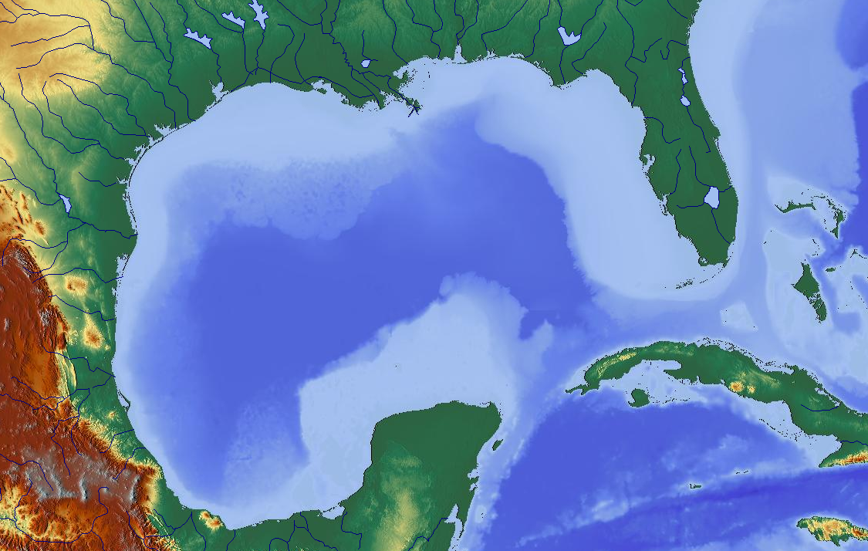
Tuna spawning in the Gulf of Mexico
The Gulf of Mexico is a major spawning ground for Atlantic tunas, including
  Atlantic bluefin tuna (Thunnus thynnus)
  Yellowfin tuna (Thunnus albacares)
  Blackfin tuna (Thunnus atlanticus)
  Skipjack tuna (Katsuwonus pelamis)
These species are commercially valuable, and some have been subject to heavy exploitation, and overfishing
Western Atlantic Bluefin Tuna: Median estimate of
spawning stock biomass (ICCAT)

Slide 3
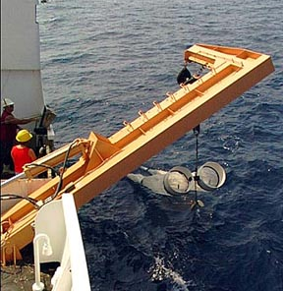
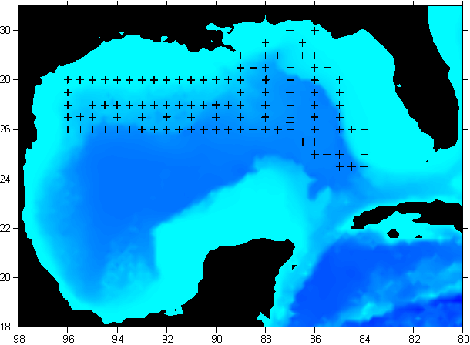
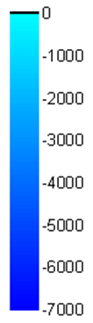
Larval collections and spawning areas
Annual spring (April – June) plankton surveys have been completed across the northern Gulf of Mexico since 1977
These surveys were primarily designed to target bluefin tuna, however larvae of other tuna were also collected
Sampling methods included bongo net tows, neuston net tows, and CTD casts for environmental data and newly incorporated shallow subsurface net tows
Loop Current
Depth (m)
Notes:
In order to maintain or improve and regulate the tuna species (especially bluefin tuna) in a more efficient matter, this project focuses on
Producing accurate habitat models based on 34 years of sampling data, historical and real time satellite data, and also longline pelagic data to
Test and incorporate that to climate change modeling trends for future forecasting of spawning and adult habitats. We will expand our habitat modeling of other highly migratory
species that we have data for such as marlin, mackerel and swordfish.
SST mean seasonality trends -- Newly incorporated shallow subsurface net

Slide 4
Larval collections and spawning areas
Historically, skipjack tuna and yellowfin/blackfin tuna larvae have been collected across the northern Gulf of Mexico during spring, with the exception of shallower continental shelf waters
Bluefin tuna larvae were collected in lower numbers, especially in the eastern Gulf, where the Loop Current is usually present
Little is known about spawning activity in the southern Gulf of Mexico
Skipjack Tuna
Yellowfin/Blackfin Tuna
Bluefin Tuna

Slide 5
Larval and adult seasonality
Yellowfin/blackfin tuna larvae were most abundant during summer, while bluefin tuna showed a strong spring peak
Skipjack tuna larvae were found from spring to fall, increasing in occurrence through the year
Adult catches generally reflected larval seasonalities, although yellowfin and bluefin tuna in particular appeared to occupy the Gulf of Mexico outside spawning seasons, and skipjack tuna adults were caught more frequently in winter
Seasonal occurrences of adults and larvae
Notes:
Before the modeling and habitat classification, we have to study the data and understand that the different species have different spawning and adult seasonality trends
Within the Gulf of Mexico and beyond.
Larvae is percent occurrence Adults is CPUE

Slide 6
Biological processes and temperature
Occurrences of tuna larvae were well correlated with temperature, both at the surface, and at 200m depth
Occurrences of skipjack and yellowfin/blackfin tuna larvae increased with increasing surface temperatures, while occurrences of bluefin tuna larvae peaked at ~ 25-27°C
Probabilities of collecting skipjack and yellowfin/blackfin larvae also increased with increasing temperature at depth, while occurrences of bluefin tuna larvae decreased
Within Loop Current/eddy
Notes:
Probability of occurrence

Slide 7
Spawning grounds and climate change
Spawning and migration processes in tunas are strongly regulated by water temperature
These species are therefore vulnerable to the effects of climate change
To assess potential spatiotemporal changes to spawning grounds, future temperatures at the surface and at 200m depth were extracted from a coupled ocean-atmosphere, downscaled regional climate model
This model was constrained with boundary conditions obtained from a weighted combination of IPCC models under the SRES A1B CO₂ emission scenario
Predicted temperatures during the mid and late 21st century, as well as climatological data from the late 20th century, were applied to species specific spawning habitat models
Gains and losses in monthly spring spawning habitat were then quantified
Notes:
Based on the strongest correlation between adult migration/ spawning and water temperature.
IPCC AR4 (Intergovernmental Panel on Climate Change) SRES (Special Report on Emissions Scenarios)
MICOM (Miami Isopycnic Coordinate Ocean Model) with AML (atmospheric mixed layer model)
Downscaling involves taking the very low resolution predictions of the IPCC global climate models (which are too coarse to resolve features such as the
Loop Current), and building a regional, higher-resolution model. There's a few different ways to do this. We used dynamical downscaling:
this basically involves running an ocean model into the future, and nudging it towards the boundary conditions supplied by the low-res IPCC models.
What you end up with is an ocean model (rather like Hycom etc) which predicts temperature and flow fields at a higher-resolution through to 2100.

Slide 8
Modeling larval distributions
Probability of larval occurrence (/1)
Predicted and actual larval distribution from CTD model :1983
Predicted and actual larval distribution from satellite model :2010
Previous research has focused on describing environmental predictors of bluefin tuna spawning in the Gulf of Mexico
Using environmental variables from in situ CTD casts, a larval habitat model was constructed
Bluefin tuna larval distributions were strongly related to temperature, and were low inside the Loop Current, and warm-core eddies
This approach was then extended to use remotely sensed satellite data to predict spawning areas, rather than in situ CTD cast data
Notes:
SST, CHL, SSH and geostrophic velocities,depth and time of year, in the remotely sensed habitat model.

Slide 9
Spawning habitat models
A classification tree approach was initially used, with models then refined using multilayer perceptron neural networks
The existing model for bluefin tuna larvae was modified to run only on temperature data, and results were applied to temperature predictions from the downscaled climate model
This approach was then repeated for the other two taxa
All samples
N = 1101
T200m < 21.3
N =1106
Positive Stn
T200m > 21.3
N =95
Negative Stn
SST < 23.4
N =114
Negative Stn
SST > 23.4
N =892
Positive Stn
T200m < 17.1
N = 699
Positive Stn
T200m > 17.1
N = 193
Negative Stn
SST < 28.8
N = 686
Positive Stn
SST > 28.8
N = 13
Negative Stn
SST < 25.6
N = 30
Positive Stn
SST > 25.6
N = 163
Negative Stn
Notes:
Taxa = other species

Slide 10
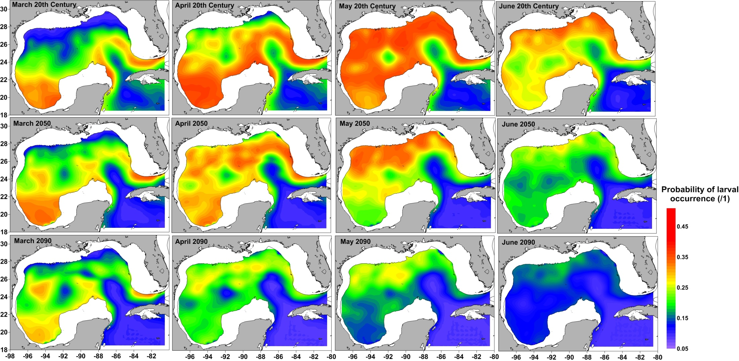
Spawning habitat results: Bluefin tuna
During the late 20th century, bluefin tuna spawned in the northern Gulf of Mexico in May and June, with less activity in April. Larvae were rarely collected from within the Loop Current or warm eddies
By the end of the 21st century, it is predicted that the habitat in the northern Gulf will be slightly more suitable in March and April, however much of the May and June habitat is predicted to disappear
Notes:
Climate models just SST and 200m Temp

Slide 11
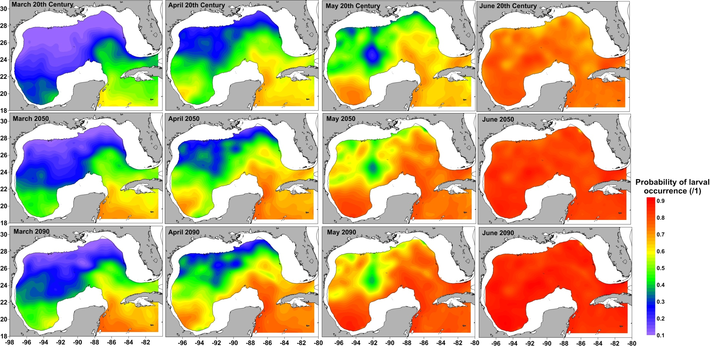
Spawning habitat results: Yellowfin/blackfin tuna
During the late 20th century, Thunnus spp. increased spawning activity throughout spring
By the end of the 21st century, warming temperatures are predicted to increase the suitability of spawning habitat in all spring months

Slide 12
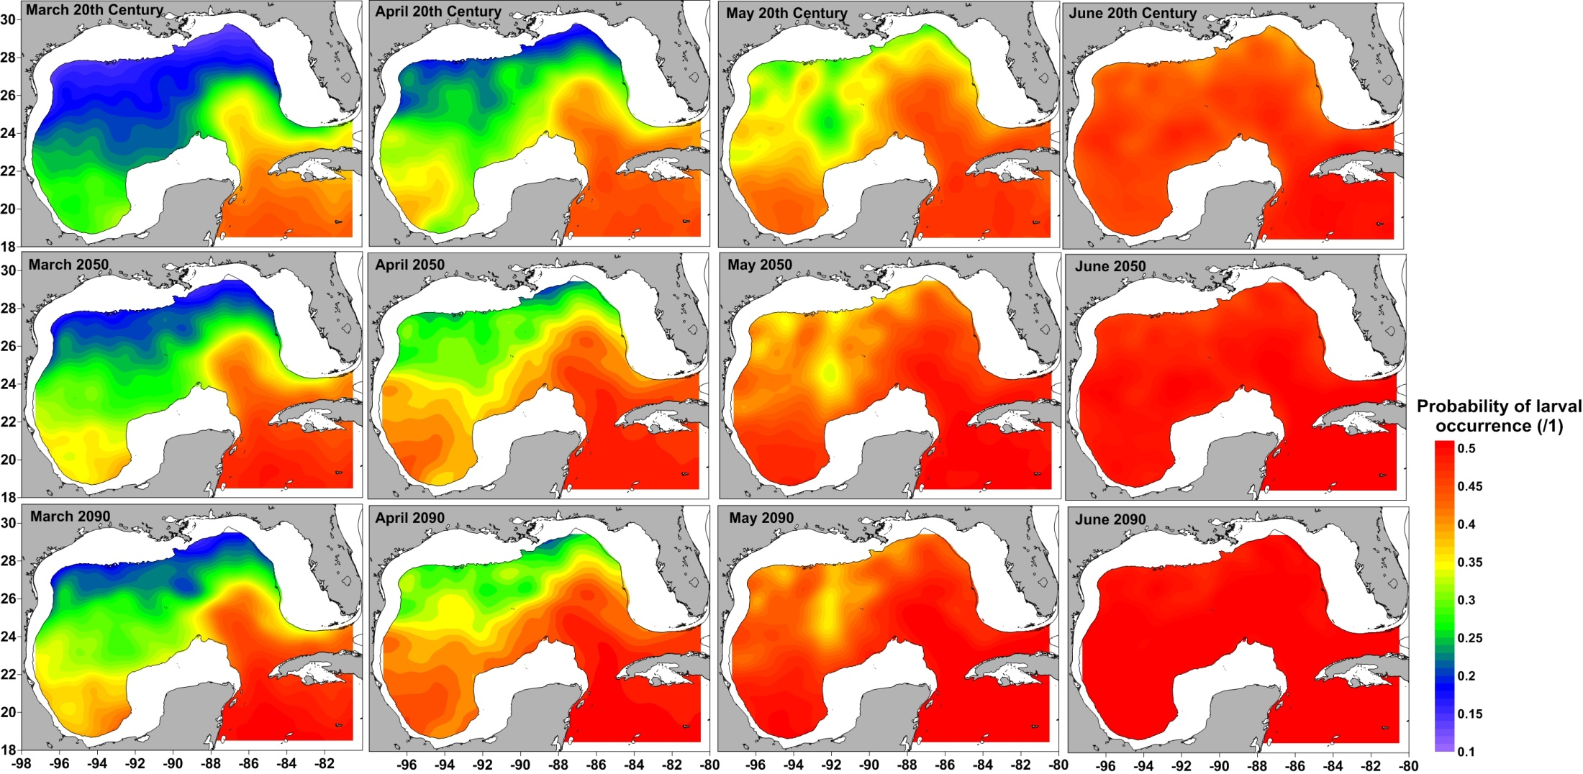
Spawning habitat results: Skipjack tuna
Similarly to yellowfin/blackfin tuna, skipjack tuna spawning grounds are predicted to increase in suitability through to the end of the 21st century

Slide 13
Physiological limits of adult occurrence: Bluefin tuna
Although well adapted to survive cold water on feeding grounds, adult bluefin tuna are less well adapted to very warm waters (Blank et al., 2004)
Classification of predicted surface temperatures based on published ranges suggests an increasingly stressful environment in May and June, particularly at entry points to the Gulf
Notes:
Decadal changes in adult BFT

Slide 14
Spawning habitat loss and gain
Mean probabilities of occurrence for yellowfin/blackfin tuna and skipjack tuna increased in all spring months in the northern Gulf of Mexico
In contrast, bluefin tuna larval occurrences were predicted to stay similar to 20th century levels in March and April, and decrease strongly in May and June: the months which currently show strongest spawning activity
Notes:
Mean Probability of occurrence

Slide 15
Conclusions and future research directions
Increasing water temperatures in the Gulf of Mexico are likely to result in spatial and temporal shifts in spawning grounds
Bluefin tuna is likely to lose spring spawning habitat, while tropical tunas are likely to show earlier initiation of spawning
In the future, we hope to examine the effects of water temperature on larval growth and survival
In addition, effects of climate change migration patterns will be examined and the modeled climate change area expanded
Once the IPCC-AR5 models are available, we would also like to make use of the biological predictions, and apply results to models of larval feeding, growth and survival
Model Validation?
Notes:
Expand the area of modeling to the Caribbean Sea (already in progress) and out to the Atlantic Ocean to the Med.

Slide 16
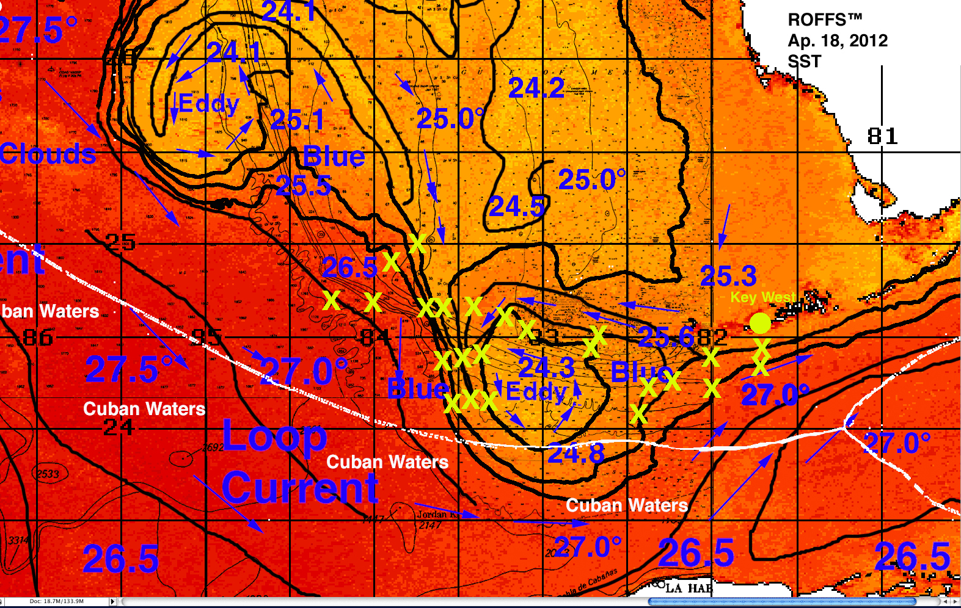
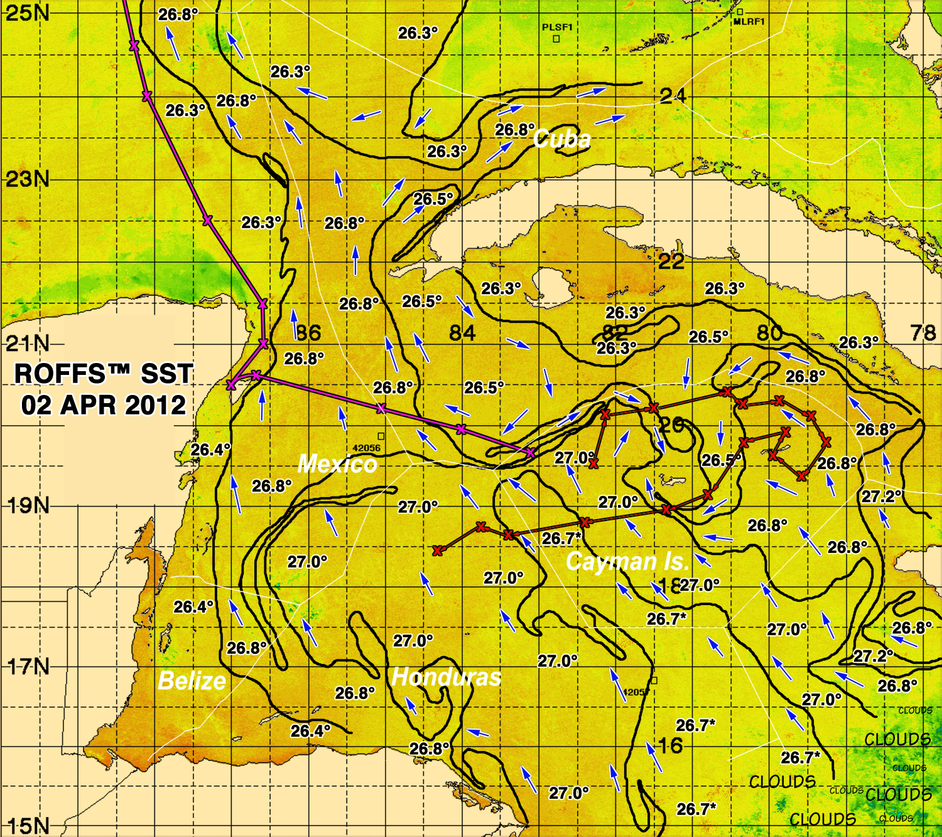
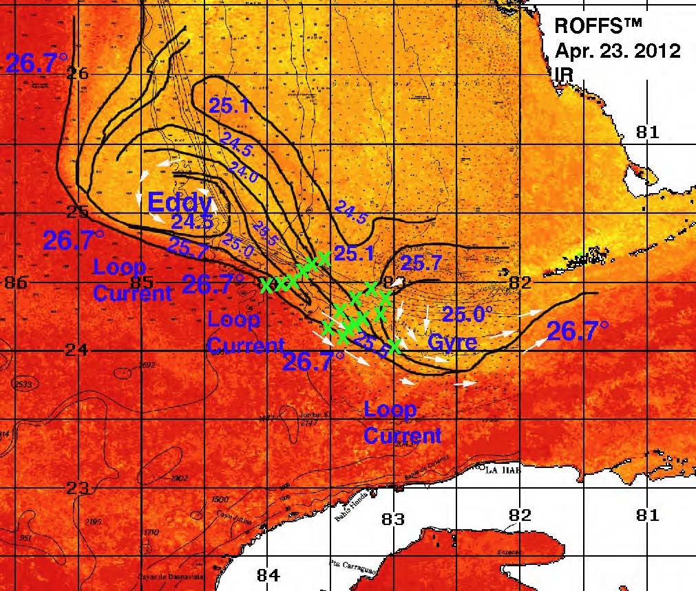
NOAA Spring Research Cruise Support
Real Time Oceanographic Data and Analysis
Notes:
16

Slide 17
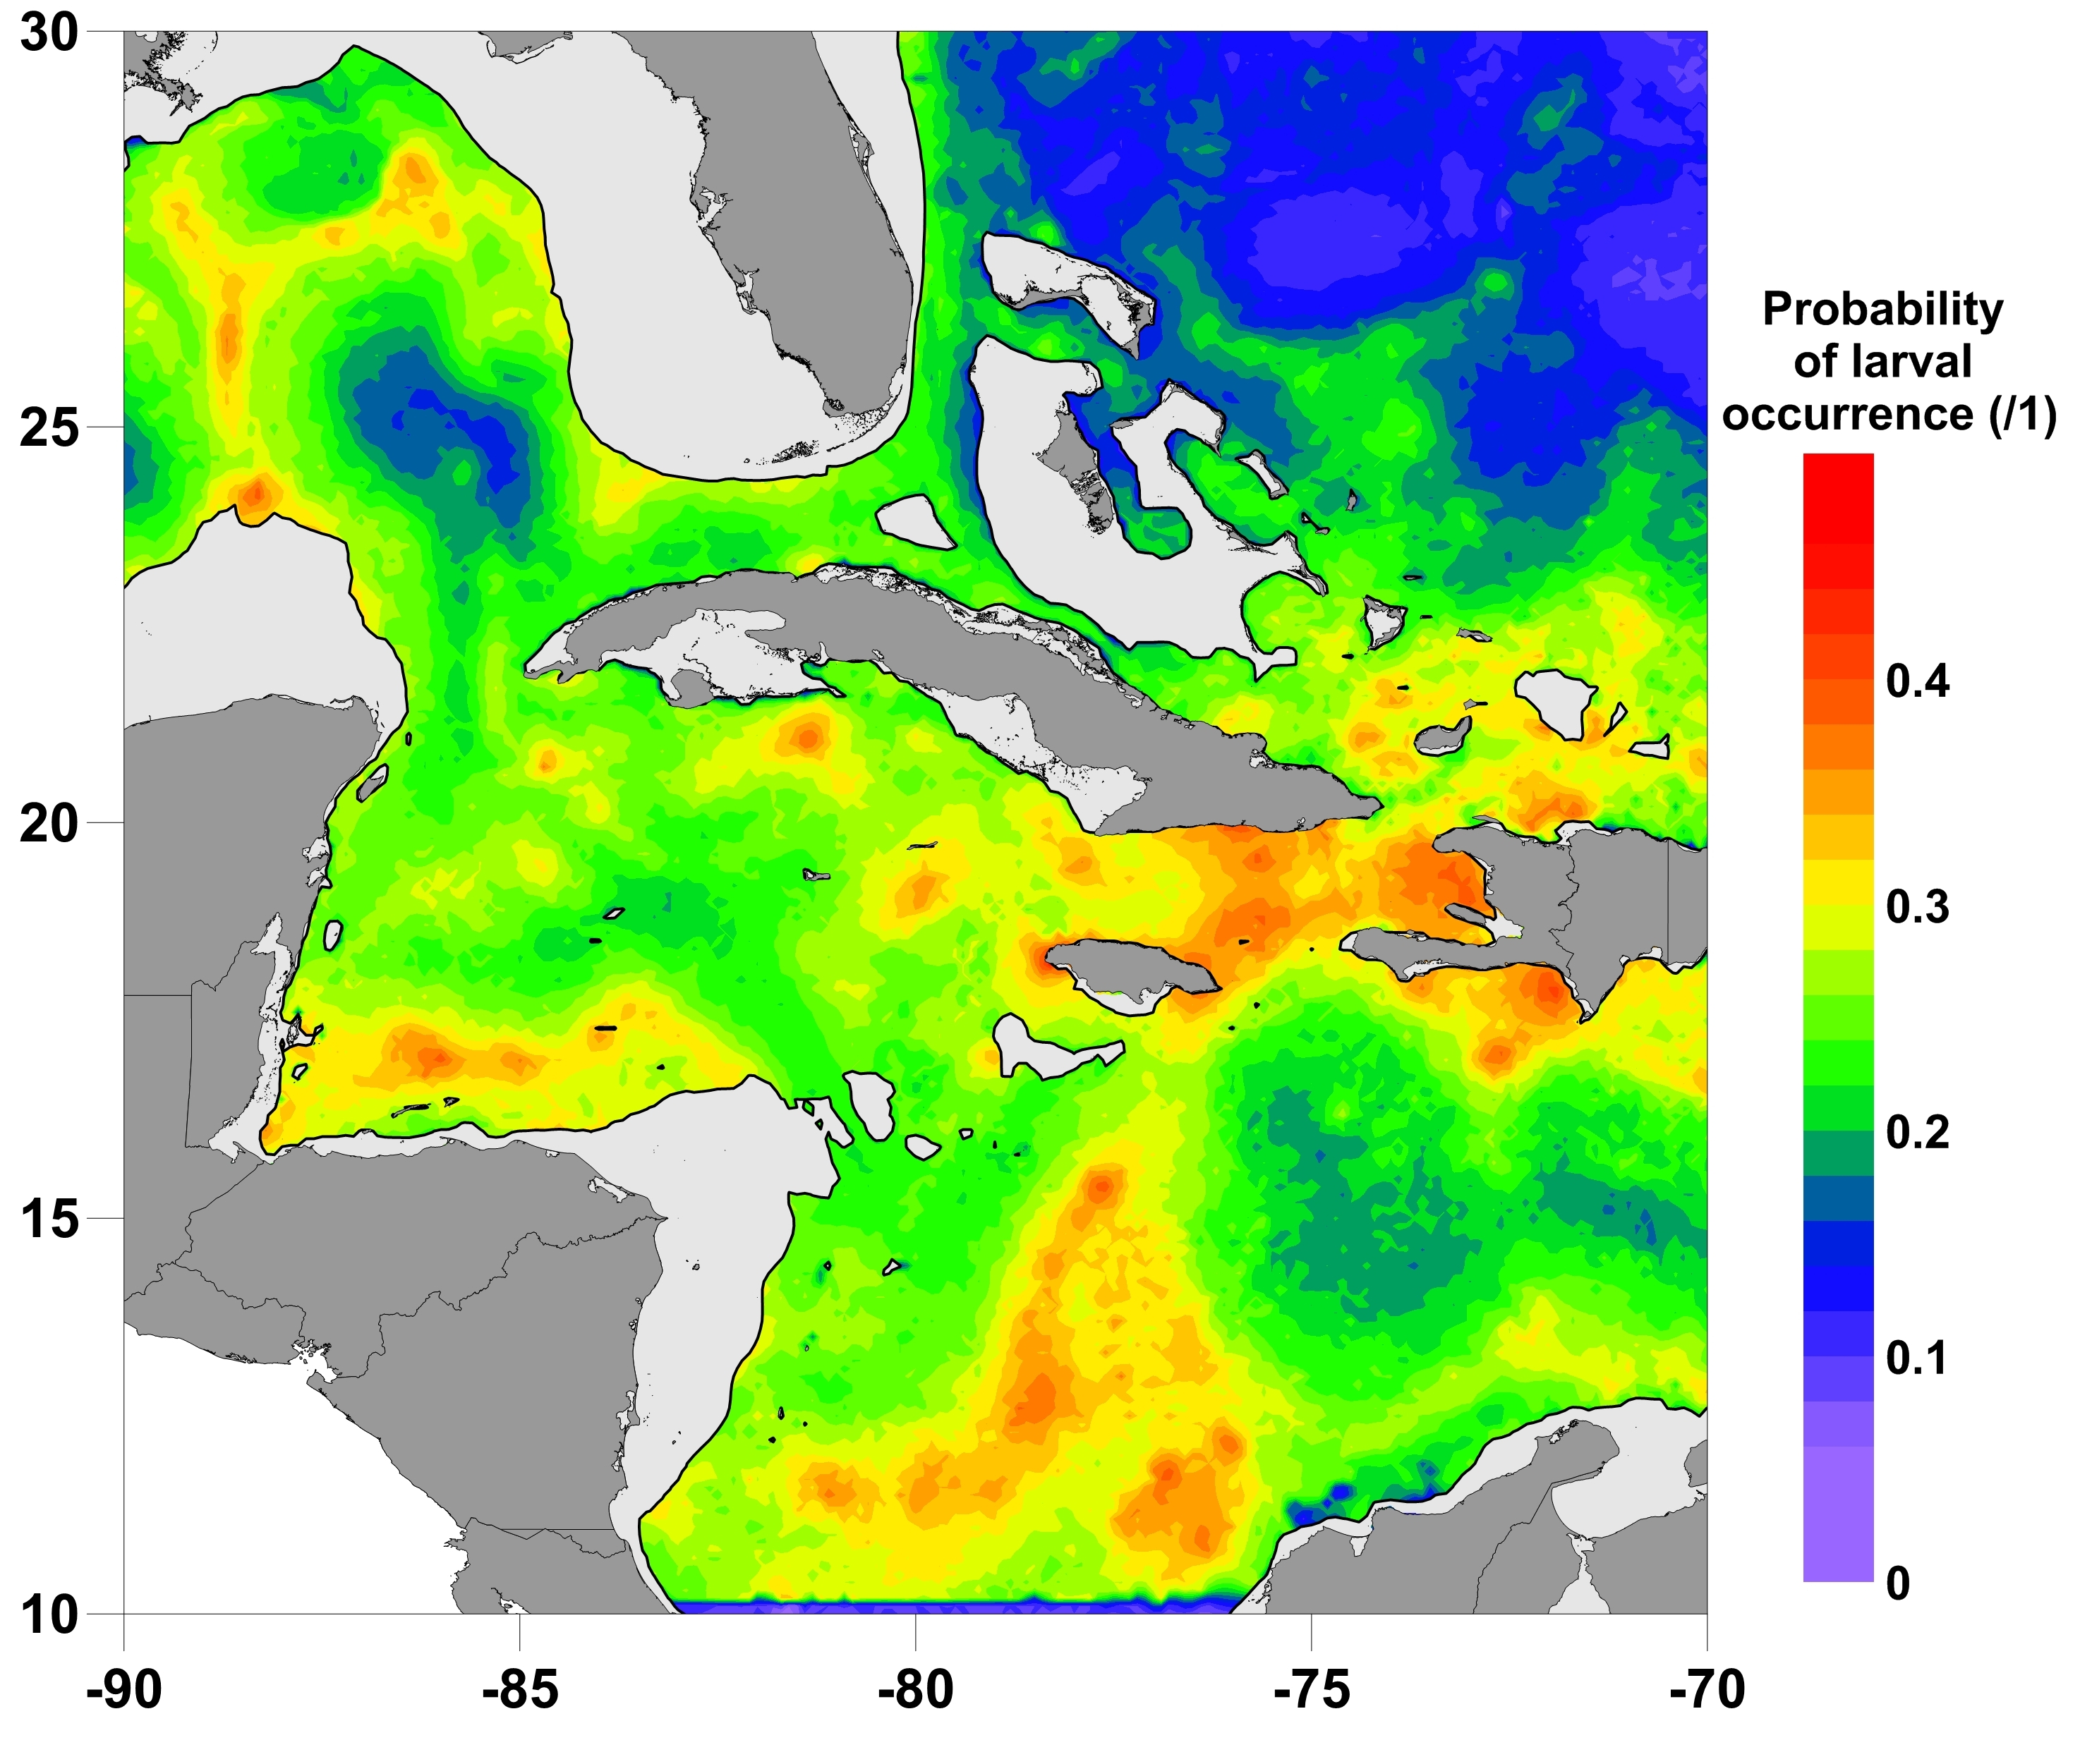
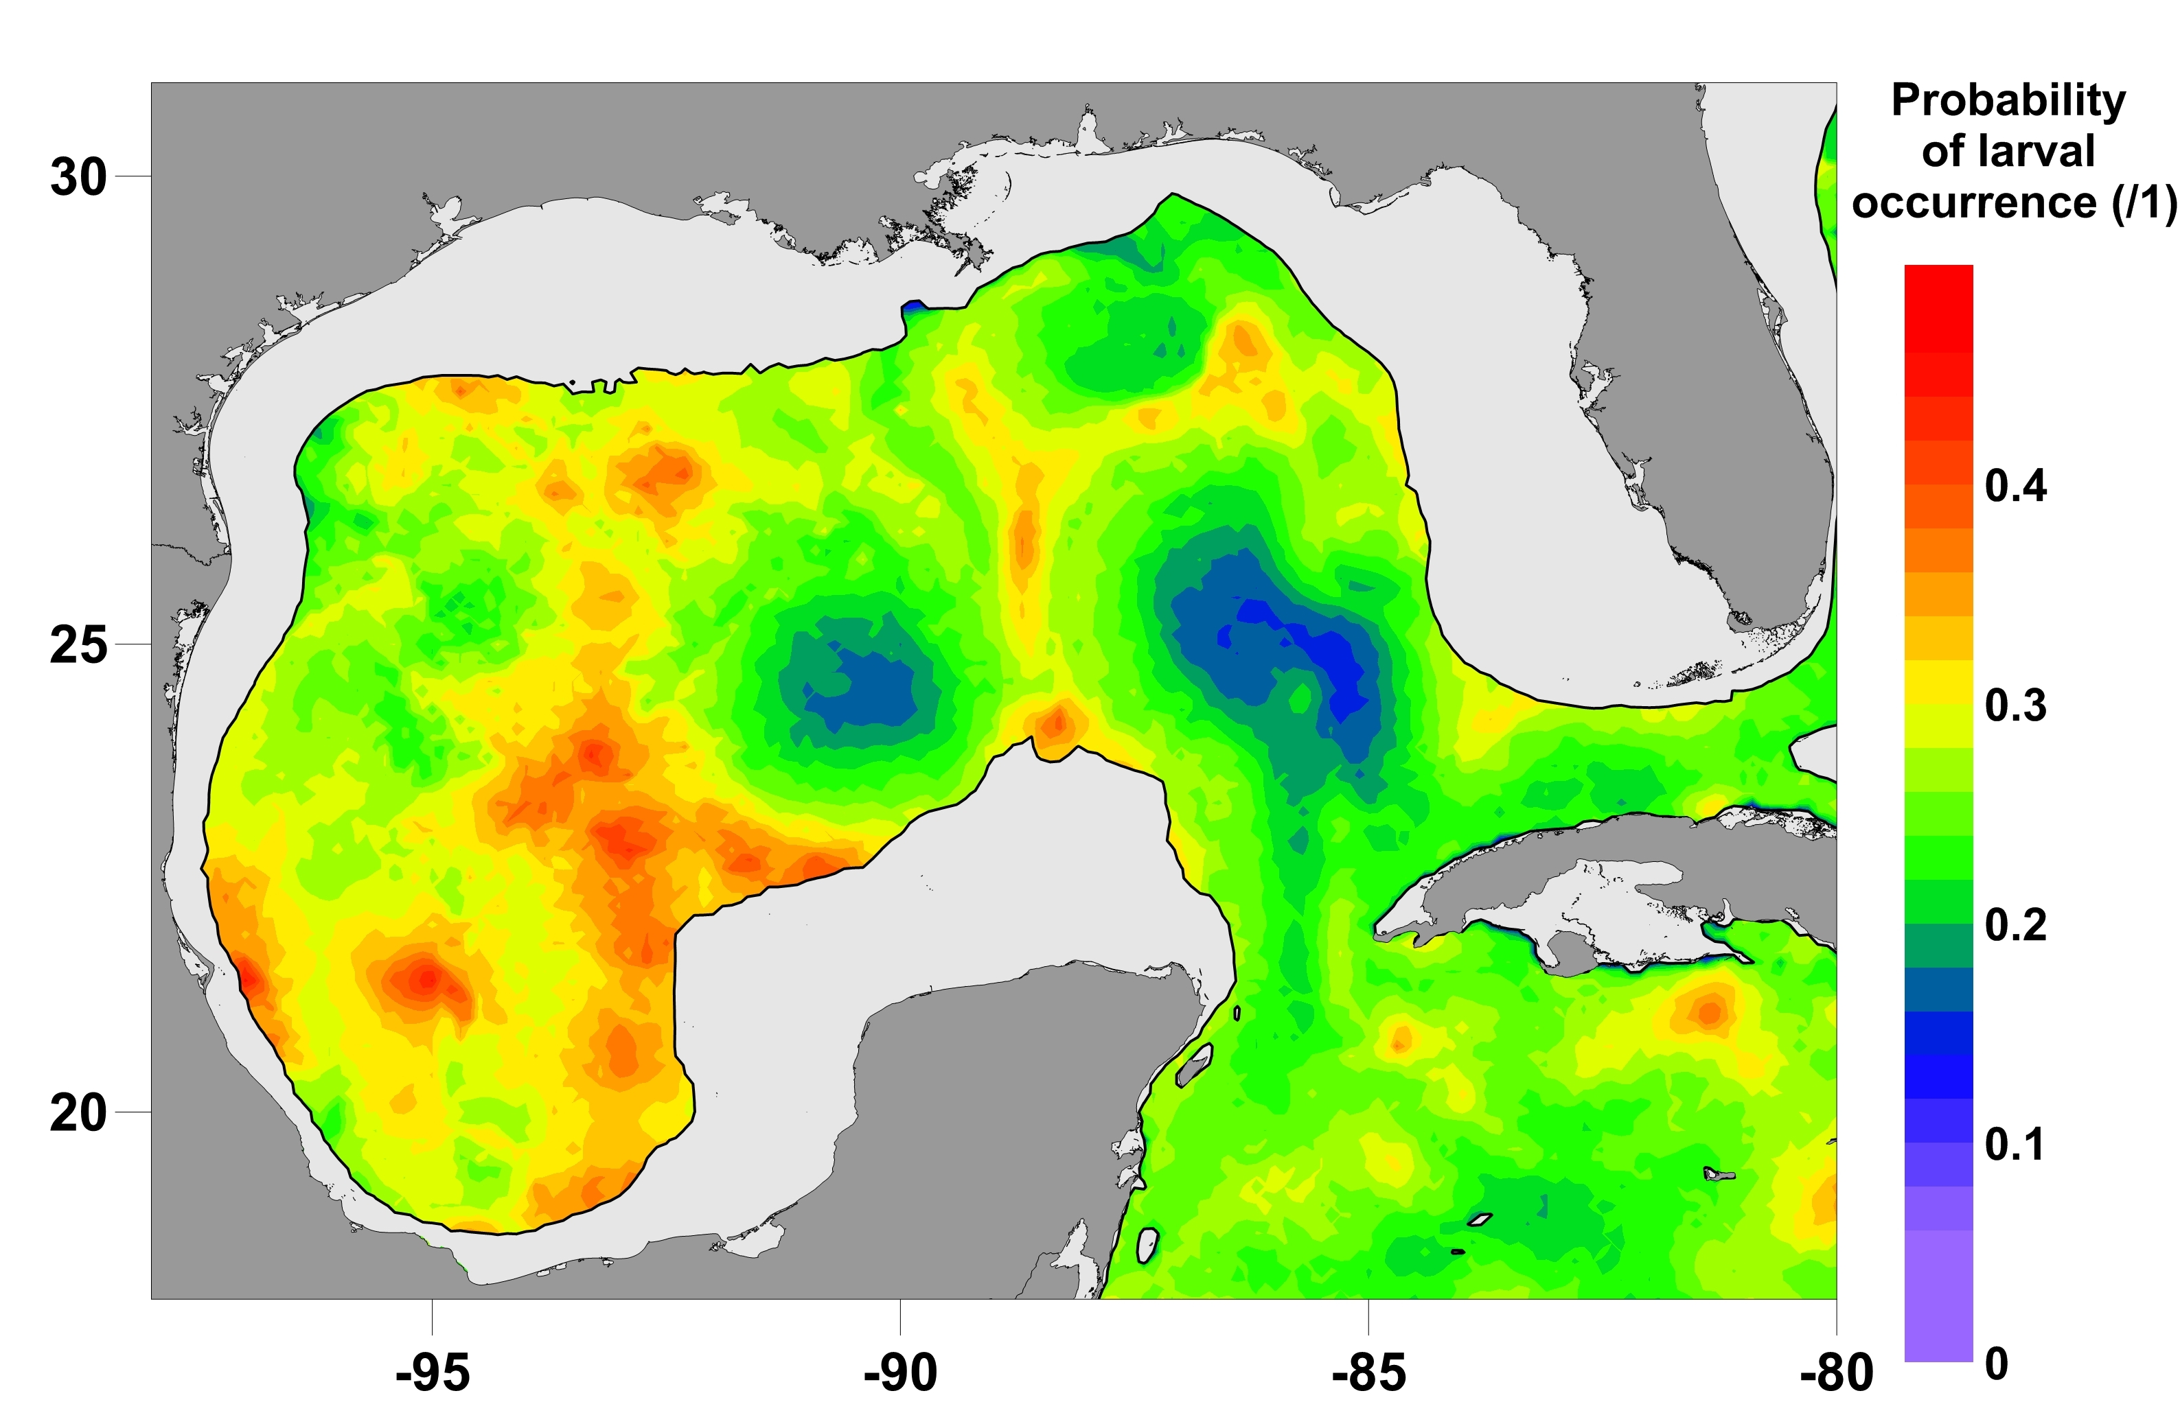
Bluefin Tuna spawning habitat model recent conditions (08-14 April 2012)
Notes:
17

Slide 18
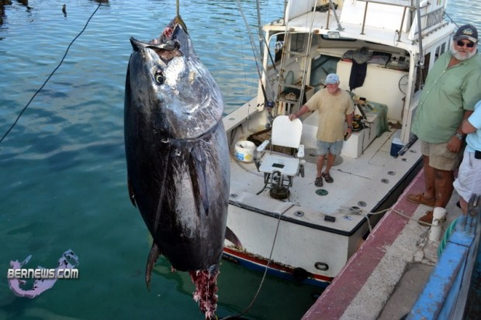
Acknowledgements
NOAA-NMFS
  South East Fisheries Science Centre
    Early Life History Group
    Stock Assessment Division
  Pascagoula Laboratory
    Kim Williams
    Joanne Lyczkowski-Shultz
    David Hanisko
    Denice Drass
    Walter Ingram
NOAA-AOML
    Ryan Smith
Rosentiel School of Marine and Atmospheric Science
  Andrew Bakun
Fisheries and the Environment (FATE)
University of South Florida
  Frank Muller-Karger
  Sennai Habtes
ROFFS Ocean Fishing Forecasting Service
    Mitch Roffer
    Greg Gawlikowski
    Matthew Upton
The University of Southern Mississippi
  Jim Franks
  Bruce Comyns
The University of South Carolina
  Joe Quattro
  Mark Roberts
INAPESCA Mexico
  Karina Ramirez
NASA - Biodiversity and Ecological Forecasting
National Research Council (NRC)
Plankton Sorting and Identification Center, Szczecin, Poland
The University of Miami Cooperative Institute for Marine and Atmospheric Studies
References and publications
Spawning habitat model: Muhling, B.A., Lamkin, J.T., Roffer, M.A. (2010) Predicting the occurrence of bluefin tuna (Thunnus thynnus) larvae in the northern Gulf of Mexico: Building a classification model from archival data Fisheries Oceanography 19: 526-539.
Alternate spawning areas: Muhling, B.A., Lamkin, J.T., Quattro, J.M., Smith, R.A., Roberts, M.A., Roffer, M.A., Ramirez, K.A. (2011) Collection of larval bluefin tuna (Thunnus thynnus) outside documented western Atlantic spawning grounds. Bulletin of Marine Science 87: 687-694.
Bluefin tuna and climate change: Muhling, B.A., Lee, S-K, Lamkin, J.T. (2011) Predicting the effects of climate change on bluefin tuna (Thunnus thynnus) spawning habitat in the Gulf of Mexico. ICES Journal of Marine Science 68: 1051-1062.
The larval index: Ingram, G.W. Jr., Richards, W.J., Lamkin, J.T., Muhling, B.A. (2010) Annual indices of Atlantic bluefin tuna (Thunnus thynnus) larvae in the Gulf of Mexico developed using delta-lognormal and multivariate models. Aquatic Living Resources 23: 35-47.
Bluefin tuna larvae and the 2010 oil spill: Muhling, B.A., Roffer, M.A., Lamkin, J.T., Ingram, G.W. Jr., Upton, M.A., Gawlikowski, G., Muller-Karger, F., Habtes, S., Richards, W.J. (2012) Overlap between Atlantic blueﬁn tuna spawning grounds and observed Deepwater Horizon surface oil in the northern Gulf of Mexico. Marine Pollution Bulletin, doi:10.1016/j.marpolbul.2012.01.034

